Slide 1
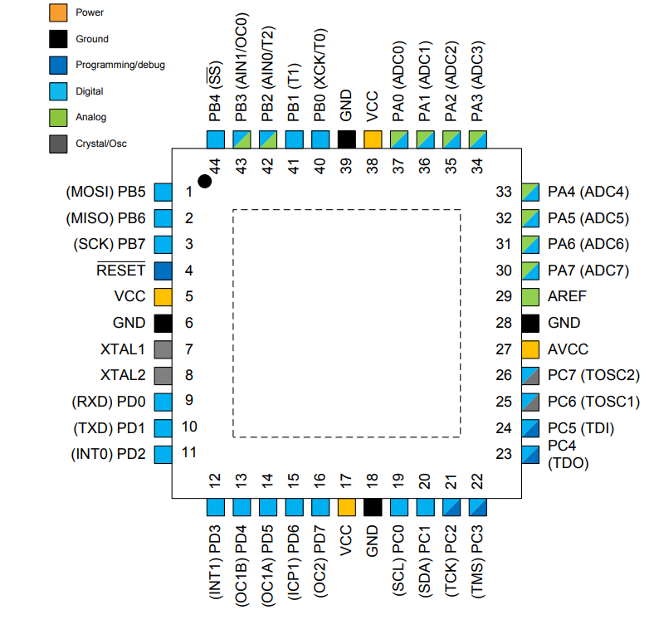
Smart Home
ATMega32

Slide 2
Smart Home
ATMega32

Slide 3
Smart Home
ATMega32
32 x 8 GPIOs
ADC
USART
EEPROM
Timers
Interrupts

Slide 4
Smart Home
Motives & Objectives
Address the growing demand for smart home automation systems.
Explore the potential of embedded systems in enhancing daily living.
Apply theoretical knowledge gained during ITI Basic Embedded Training to a practical project.
Collaborate with a talented team to develop innovative solutions in the field.

Slide 5
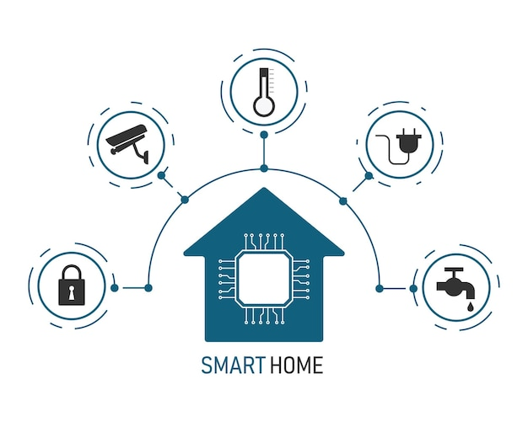
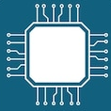
Smart Home
UART
Slave
Master

Slide 6
Smart Home
UART
Slave
Master

Slide 7
Smart Home
UART
Slave
Master

Slide 8
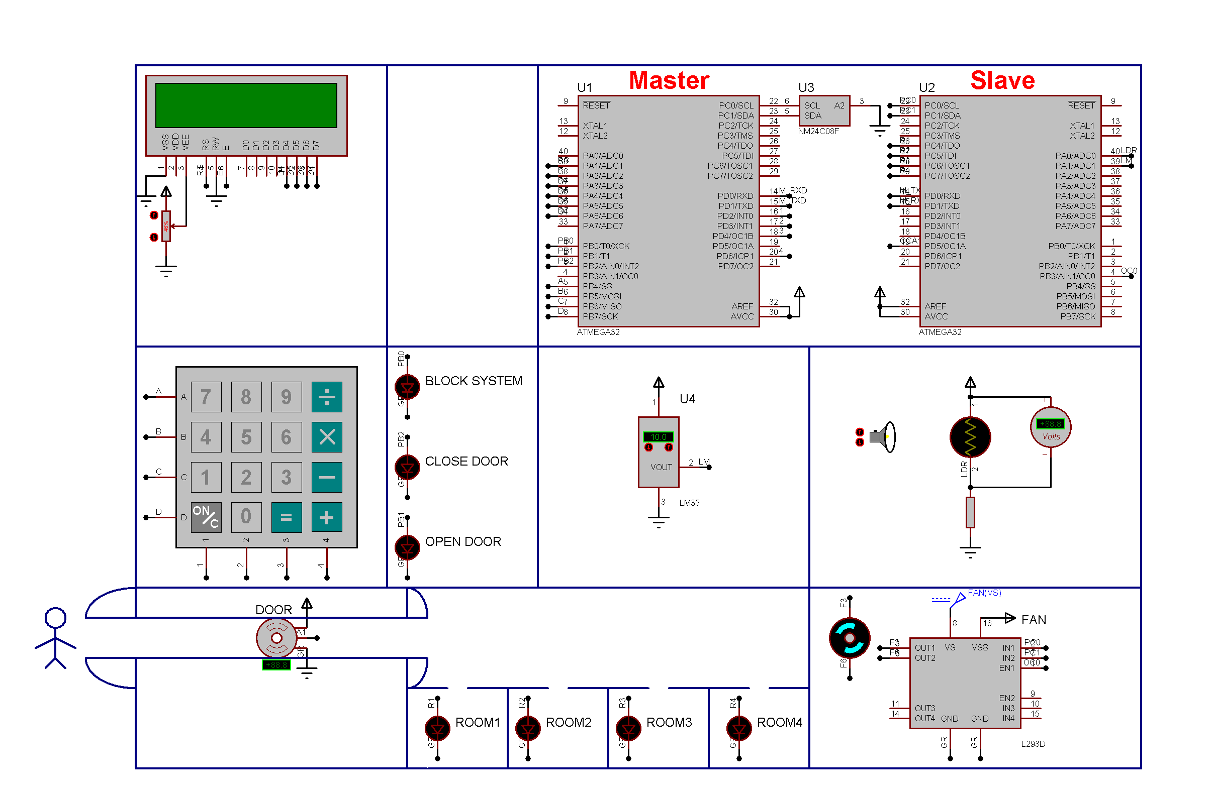
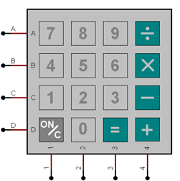

Slide 9
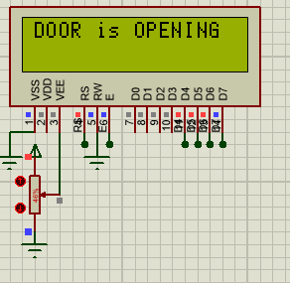
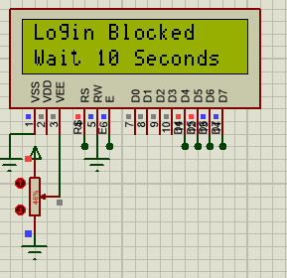
Smart Home
User-friendly interface allows the owner to set a password for the first time, which is stored safely in the EEPROM.
After a password is set, access the house is granted only after entering the password.
If the user fails to enter the correct password thrice, the system will enter block mode and a buzzer will sound.
If the password is correct, the door will automatically open for a period of time then close.

Slide 10
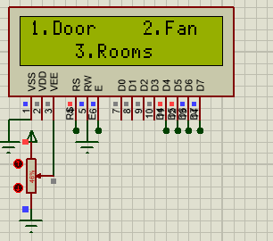
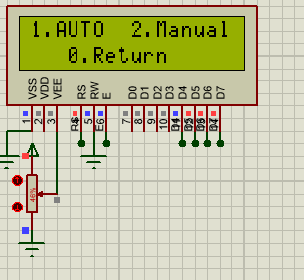
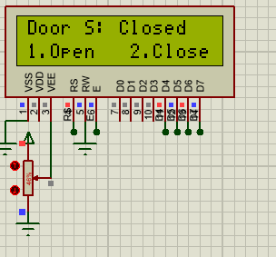
Door Options

Slide 11
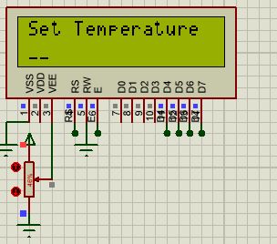
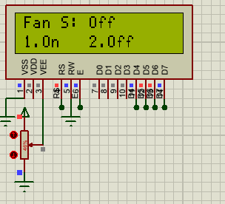
Fan Options

Slide 12
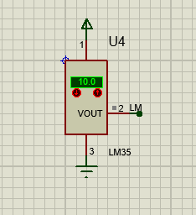
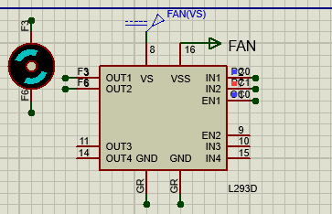
Fan Options
Multi-speed Fan

Slide 13
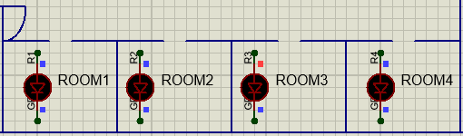
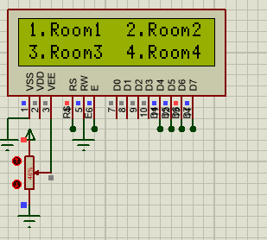
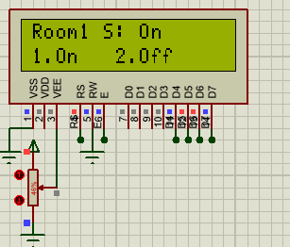
Lights Options

Slide 14
Lights Options

Slide 15
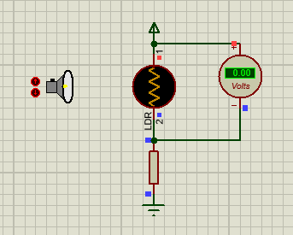
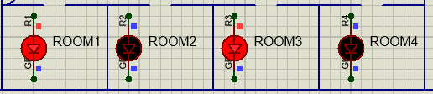
Lights Options

Slide 17
Smart Home
Components Used
Drivers Used
ATMEGA32
LCD
Keypad
Servo Motor
LM35
LDR
DC Motor
LEDs
Buzzer
External EEPROM
LCD 4-bit mode
Keypad
Global Interrupts
DIO
External EEPROM
I2C
UART
ADC
Timers

Slide 18
Smart Home
Next Steps
Mobile Application
Wireless UART communication.
Remote Controller
Admin and guest modes, with guest having limited functionality.

Slide 19
Smart Home
Thank you

